Slide 1




ASP.NET Core Identity
Authentication, Users & Roles
C# MVC Frameworks
SoftUni Team
Technical Trainers
Software University
http://softuni.bg

Slide 2

Table of Contents
Authentication and Authorization – Concepts
ASP.NET Identity System – Overview
Authorization and User Roles
Remote Authentication
Configuring External Login in ASP.NET MVC

Slide 3
Questions
sli.do #csharp-web

Slide 4
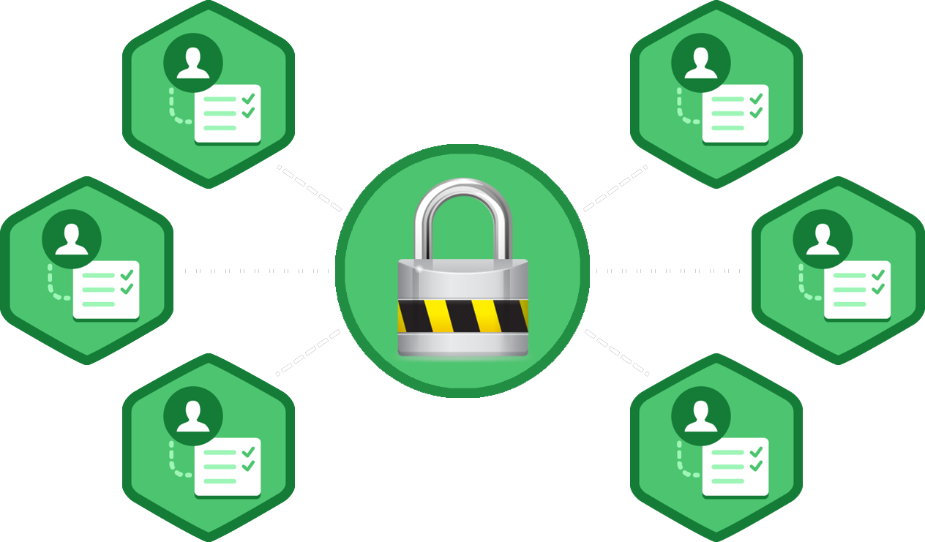
Authentication and Authorization
What's the Difference?

Slide 5
Authentication vs. Authorization
Authentication
The process of verifying the identity of a user or computer
Questions: Who are you? How you prove it?
Credentials can be password, smart card, external token, etc.
Authorization
The process of determining what a user is permitted to do on a computer or network
Questions: What are you allowed to do? Can you see this page?

Slide 6



ASP.NET CORE Identity System
Overview

Slide 7

ASP.NET Identity
The ASP.NET CORE Identity system
Authentication and authorization system for ASP.NET CORE Web apps
Supports ASP.NET MVC, Web API, SignalR
Handles users, user profiles, login / logout, roles, etc.
Keeps the user accounts in local database or in external data store
External login (through OAuth)
Supports Facebook, Google, Microsoft, Twitter accounts
Based on the OWIN middleware (can run outside of IIS)
Available through the NuGet package manager

Slide 8
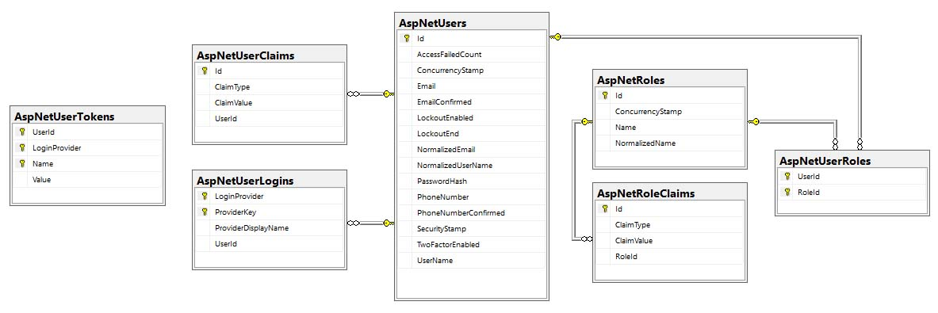
ASP.NET Identity and Entity Framework
Typically, the ASP.NET CORE identity data (users, passwords, roles) is stored in relational database through EF Code First
You have some control over the internal database schema

Slide 9



ASP.NET CORE Identity API
Setup, Registration, Login, Logout

Slide 10
ASP.NET Identity System Setup
Ways to setup ASP.NET Identity based authentication in MVC
Using the ASP.NET project templates from Visual Studio
By hand: install NuGet packages, manual configuration, create EF mappings (models), view models, controllers, views, etc.
Required NuGet packages
Microsoft.AspNetCore.Identity.EntityFrameworkCore
Microsoft.AspNetCore.Identity
Microsoft.AspNetCore.Owin

Slide 11


ASP.NET Project Template Authentication
Password settings – can be defined in Startup.cs
AccountController.cs
Implements the user login / logout
Supports external login, e.g. Facebook login
Two-factor authentication (email confirm)
public void ConfigureServices(IServiceCollection services) {
services.AddIdentity<ApplicationUser, IdentityRole>(options
=> { // Password validation rules })
.AddEntityFrameworkStores<ApplicationDbContext>()
.AddDefaultTokenProviders();
}

Slide 12

ASP.NET Project Template Authentication (2)
ApplicationUser.cs – can add user functionality
Extends the user information for the ASP.NET CORE application derived from IdentityUser
Id (unique user ID, string holding a GUID)
E.g. 313c241a-29ed-4398-b185-9a143bbd03ef
Username (unique username), e.g. maria
Email (email address – can be unique), e.g. mm@gmail.com
May hold additional fields, e.g. first name, last name, date of birth

Slide 13

ASP.NET Project Template Authentication (3)
ApplicationDbContext.cs
Holds the EF data context
Provides access to the application’s data using model objects
Startup.cs
Can configure cookie-based authentication
May enable external login (e.g. Facebook login)

Slide 14
User Registration
var newUser = new ApplicationUser
{
UserName = "maria",
Email = "mm@gmail.com",
PhoneNumber = "+359 2 981 981"
};
var result = await userManager.CreateAsync(newUser, "S0m3@Pa$$");
if (result.Succeeded)
// User registered
else
// result.Errors holds the error messages

Slide 15
User Login / Logout
Login
Logout
bool rememberMe = true;
bool shouldLockout = false;
var signInStatus = await signInManager.PasswordSignInAsync(
"maria", "S0m3@Pa$$", rememberMe, shouldLockout);
if (signInStatus.Succeeded)
// Sucessfull login
else
// Login failed
await signInManager.SignOutAsync();

Slide 16
Change Password
Logged-in user changes his password:
Administrator resets some user's password:
var currentUser = await userManager.GetUserAsync(User);
var result = await userManager.ChangePasswordAsync(
user, "old pass", "new pass");
if (result.Succeeded) { … }
else { result.Errors holds the error messages }
var user = await userManager.FindByEmailAsync(model.Email);
var token = await userManager.GeneratePasswordResetTokenAsync(user);
var result = await userManager.ResetPasswordAsync(
user, token, "new password");

Slide 17
Extending the User Profile
To extend the user profile
Just add properties to ApplicationUser class
Add a migration with the newly created properties
Apply the migration to the database
public class ApplicationUser : IdentityUser
{
[Required]
public string Name { get; set; }
…
}

Slide 18



Authorization and User Roles
Access Permissions According Roles

Slide 19
ASP.NET Authorization
Use the [Authorize] and [AllowAnonymous] attributes to configure authorized / anonymous access for controller / action
[Authorize]
public class AccountController : Controller
{
// GET: /Account/Login (annonymous)
[AllowAnonymous]
public async Task<IActionResult> Login(string returnUrl) { … }
// POST: /Account/LogOff (for logged-in users only)
[HttpPost]
public async Task<IActionResult> Logout() { … }
}

Slide 20
Check the Currently Logged-In User
// GET: /Account/Roles (for logged-in users only)
[Authorize]
public ActionResult Roles()
{
var currentUser = await userManager.GetUserAsync(User);
var roles = await userManager.GetRolesAsync(currentUser);
ViewBag.Roles = roles;
return this.View();
}

Slide 21
Create a New Role
Roles group users to simplify managing permissions
ASP.NET CORE MVC controllers and actions can check the user role
Creating a new role:
var role = new IdentityRole("Administrator");
var result = await roleManager.CreateAsync(role);
if (! result.Succeeded)
{
throw new Exception(string.Join("; ", roleCreateResult.Errors));
}

Slide 22
Add User to a Role
Adding a user to existing role:
var roleName = "Administrator";
var roleExists = await roleManager.RoleExistsAsync(roleName);
if (roleExists)
{
var user = await userManager.GetUserAsync(User);
var result = await userManager.AddToRoleAsync(user, roleName);
if (result.Succeeded)
// The user is now Administrator
}

Slide 23
Require Logged-In User in Certain Role
Give access only to users in role "Administrator":
Give access if user's role is "User", "Student" or "Trainer":
[Authorize(Roles="Administrator")]
public class AdminController : Controller
{ … }
[Authorize(Roles="User, Student, Trainer")]
public ActionResult Roles()
{
…
}

Slide 24
Check the Currently Logged-In User's Role
// GET: /Home/Admin (for logged-in admins only)
[Authorize]
public ActionResult Admin()
{
if (this.User.IsInRole("Administrator"))
{
ViewBag.Message = "Welcome to the admin area!";
return View();
}
return this.View("Unauthorized");
}

Slide 25

Remote Authentication
Claims-Based Authentication in ASP.NET

Slide 26

Claims-Based Authentication (1)
Claims
Piece of information identifying user
Sent as key-value pairs
Contains authentication token and/or signature
Claims-based authentication
Users authenticate on remote system
Information is passed to the application
User is authenticated and recognized

Slide 27


Claims-Based Authentication (2)
Authentication flow
User makes request to application
System redirects to external page
After authentication the external system returns back to the application with user information
Application makes request to external system to validate user
User gets access to the application

Slide 28


OAuth2
OAuth
Allows secure authentication
Simple and standard protocol
Can be used by web, desktop or mobile apps
Steps
Users tries to authenticate at application
Application relies on remote service
Application receives access token
User gets access

Slide 29
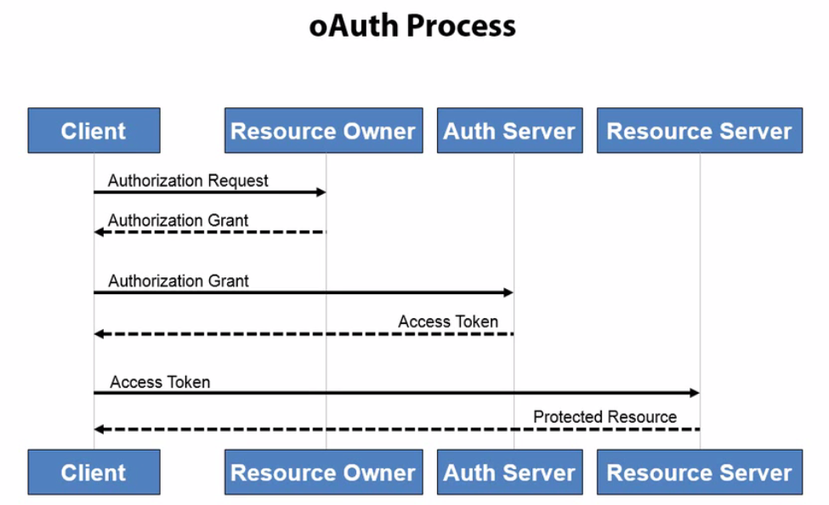
OAuth2 Process

Slide 30
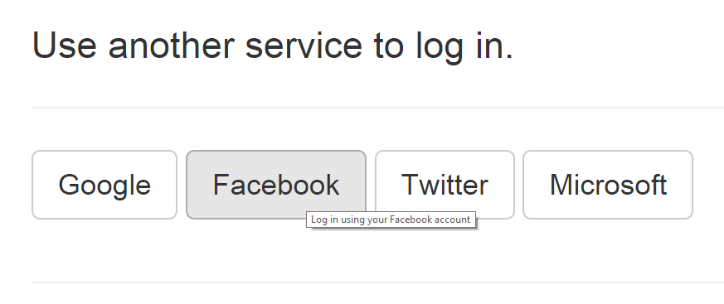
Configuring External Login
OAuth and OWIN Authorization

Slide 31

NuGet Authentication Packages
For Google account authentication
Microsoft.AspNetCore.Authentication.Google
For Facebook account authentication
Microsoft.AspNetCore.Authentication.Facebook
For Twitter account authentication
Microsoft.AspNetCore.Authentication.Twitter
For Microsoft account authentication
Microsoft.AspNetCore.Authentication.MicrosoftAccount
Other providers are available in OAuth and OpenIdConnect packages

Slide 32
Enable External Login in ASP.NET CORE
public class Startup
{
public void ConfigureServices(IServiceCollection services)
{
...
services.AddAuthentication().AddFacebook(fo =>
{
fo.AppId = Configuration["Authentication:Facebook:AppId"];
fo.AppSecret =
Configuration["Authentication:Facebook:AppSecret"];
});
}
}

Slide 33

Summary
Authentication vs. Authorization
ASP.NET Identity
Custom users
Registration, login, logout
Change password
User roles and role management
External logins

Slide 34







C# MVC Frameworks – Course Overview
https://softuni.bg/courses/asp-net-mvc

Slide 35
License
This course (slides, examples, demos, videos, homework, etc.) is licensed under the "Creative Commons Attribution-NonCommercial-ShareAlike 4.0 International" license

Slide 36





Trainings @ Software University (SoftUni)
Software University – High-Quality Education, Profession and Job for Software Developers
softuni.bg
Software University Foundation
http://softuni.foundation/
Software University @ Facebook
facebook.com/SoftwareUniversity
Software University Forums
forum.softuni.bg

